Slide 1
Design and analysis of algorithms
Presented by: Aoun-Haider
FA21-BSE-133@cuilahore.edu.pk

Slide 2
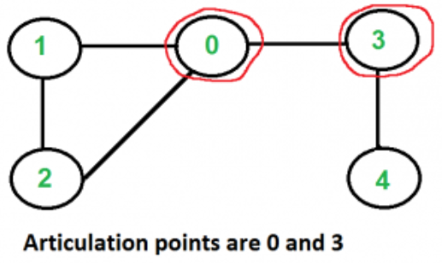
Articulation point in graph:
Articulation point is such a point in a graph which can cause dividing of graph into different graphs by deleting it.

Slide 3
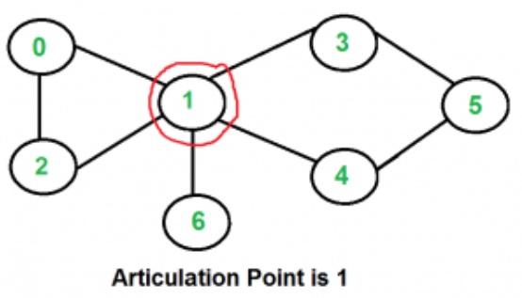
Cont.
It is important to detect articulation point because a network will be disconnected if articulation point fails. If articulation point is detected, we can apply security features on that point to prevent such failures.

Slide 4
Find articulation point in the given graph??
0
1
2
3
4
5
6
7
8

Slide 5
Step#01: Apply DFS (Depth first search)
0
1
3
4
2
5
6
7
8

Slide 6
Step#01: Draw dotted line where graph connection is available.
0
1
3
4
2
5
6
7
8

Slide 7
Assign order to each node in which
Order DFS was applied
d = 1
0
d = 2
1
d = 3
3
d = 4
4
d = 9
2
d = 5
5
d = 6
6
d = 7
 | 0 | 1 | 2 | 3 | 4 | 5 | 6 | 7 | 8
d | 1 | 2 | 9 | 3 | 4 | 5 | 6 | 7 | 8
L
7
d = 8
8

Slide 8
Compute lower index from child to
parent. For example, 1 to 0 path
is 1 -> 3 -> 2 -> 0 and minimum
value of ‘d’ is 1
d = 1
0
d = 2
1
d = 3
3
d = 4
4
d = 9
2
d = 5
5
d = 6
6
d = 7
 | 0 | 1 | 2 | 3 | 4 | 5 | 6 | 7 | 8
d | 1 | 2 | 9 | 3 | 4 | 5 | 6 | 7 | 8
L | 1 | 1 | 1 | 1 | 3 | 3 | 6 | 6 | 6
7
d = 8
8

Slide 9
Step#02: determine point
u = parent
v = child
If L[v] >= d[u]
articulation_point = u
d = 1
0
d = 2
1
d = 3
3
d = 4
4
d = 9
2
d = 5
5
d = 6
6
d = 7
 | 0 | 1 | 2 | 3 | 4 | 5 | 6 | 7 | 8
d | 1 | 2 | 9 | 3 | 4 | 5 | 6 | 7 | 8
L | 1 | 1 | 1 | 1 | 3 | 3 | 6 | 6 | 6
7
d = 8
8

Slide 10
Step#02: determine point
u = parent
v = child
If L[v] >= d[u]
articulation_point = u
d = 1
0
L[3] >= d[1]
1 >= 2
False!!
d = 2
1
d = 3
3
d = 4
4
d = 9
2
d = 5
5
d = 6
6
d = 7
 | 0 | 1 | 2 | 3 | 4 | 5 | 6 | 7 | 8
d | 1 | 2 | 9 | 3 | 4 | 5 | 6 | 7 | 8
L | 1 | 1 | 1 | 1 | 3 | 3 | 6 | 6 | 6
7
d = 8
8

Slide 11
Step#02: determine point
u = parent
v = child
If L[v] >= d[u]
articulation_point = u
d = 1
0
L[4] >= d[3]
3 >= 3
True!!
So, 3 is the articulation point.
Continue..
There can be more articulation points
d = 2
1
d = 3
3
d = 4
4
d = 9
2
d = 5
5
d = 6
6
d = 7
 | 0 | 1 | 2 | 3 | 4 | 5 | 6 | 7 | 8
d | 1 | 2 | 9 | 3 | 4 | 5 | 6 | 7 | 8
L | 1 | 1 | 1 | 1 | 3 | 3 | 6 | 6 | 6
7
d = 8
8

Slide 12
Step#02: determine point
u = parent
v = child
If L[v] >= d[u]
articulation_point = u
d = 1
0
L[2] >= d[3]
1 >= 3
False!!
d = 2
1
d = 3
3
d = 4
4
d = 9
2
d = 5
5
d = 6
6
d = 7
 | 0 | 1 | 2 | 3 | 4 | 5 | 6 | 7 | 8
d | 1 | 2 | 9 | 3 | 4 | 5 | 6 | 7 | 8
L | 1 | 1 | 1 | 1 | 3 | 3 | 6 | 6 | 6
7
d = 8
8

Slide 13
Step#02: determine point
u = parent
v = child
If L[v] >= d[u]
articulation_point = u
d = 1
0
L[5] >= d[4]
3 >= 4
False!!
d = 2
1
d = 3
3
d = 4
4
d = 9
2
d = 5
5
d = 6
6
d = 7
 | 0 | 1 | 2 | 3 | 4 | 5 | 6 | 7 | 8
d | 1 | 2 | 9 | 3 | 4 | 5 | 6 | 7 | 8
L | 1 | 1 | 1 | 1 | 3 | 3 | 6 | 6 | 6
7
d = 8
8

Slide 14
Step#02: determine point
u = parent
v = child
If L[v] >= d[u]
articulation_point = u
d = 1
0
L[6] >= d[5]
6 >= 5
True!!
So, 5 is also articulation point.
d = 2
1
d = 3
3
d = 4
4
d = 9
2
d = 5
5
d = 6
6
d = 7
 | 0 | 1 | 2 | 3 | 4 | 5 | 6 | 7 | 8
d | 1 | 2 | 9 | 3 | 4 | 5 | 6 | 7 | 8
L | 1 | 1 | 1 | 1 | 3 | 3 | 6 | 6 | 6
7
d = 8
8

Slide 15
Step#02: determine point
u = parent
v = child
If L[v] >= d[u]
articulation_point = u
d = 1
0
L[7] >= d[6]
6 >= 6
True!!
So, 6 is also articulation point.
d = 2
1
d = 3
3
d = 4
4
d = 9
2
d = 5
5
d = 6
6
d = 7
 | 0 | 1 | 2 | 3 | 4 | 5 | 6 | 7 | 8
d | 1 | 2 | 9 | 3 | 4 | 5 | 6 | 7 | 8
L | 1 | 1 | 1 | 1 | 3 | 3 | 6 | 6 | 6
7
d = 8
8

Slide 16
Step#02: determine point
u = parent
v = child
If L[v] >= d[u]
articulation_point = u
d = 1
0
L[8] >= d[7]
6 >= 7
False!!
d = 2
1
d = 3
3
d = 4
4
d = 9
2
d = 5
5
d = 6
6
d = 7
 | 0 | 1 | 2 | 3 | 4 | 5 | 6 | 7 | 8
d | 1 | 2 | 9 | 3 | 4 | 5 | 6 | 7 | 8
L | 1 | 1 | 1 | 1 | 3 | 3 | 6 | 6 | 6
7
d = 8
8

Slide 17
Conclusion:
Articulation points, also known as cut vertices, are critical elements in graph theory. An articulation point is a vertex in a graph whose removal would increase the number of connected components in the graph. In other words, if an articulation point is removed, it will disconnect the graph or split it into multiple disconnected parts.
Detection of this point important for:
- Connectivity analysis
- Network reliability
- Graph portioning
- Route planning
- Graph visualization

